Slide 1
Object Oriented Programming Lecture - 2
Prof. Varsha Dange

Slide 2
Different ways to create objects
There are five different ways to create an object in Java:
Java new Operator
Java Class.newInstance() method
Java newInstance() method of Constructor class
Java Object.clone() method
Java Object Serialization and Deserialization

Slide 3
create objects
Java new Operator
This is the most popular way to create an object in Java.
A new operator is followed by a call to constructor which initializes the new object.
While we create an object it occupies space in the heap.
new allocates memory for an object during run time.

Slide 4
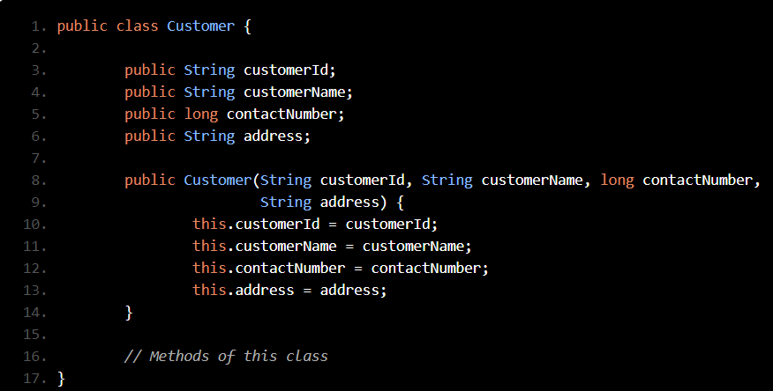
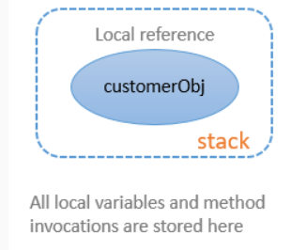
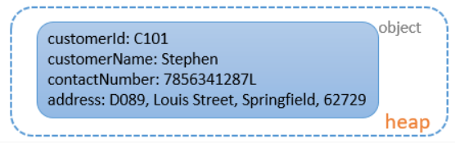

create objects
Step 1: The reference variable is created in the stack.
Step 2: The object is created in the heap.
What do you think will happen when the following statement gets executed?

Slide 5
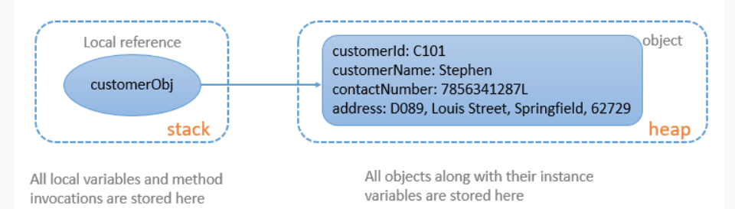
create objects
Step 3: The reference variable in the stack refers to the object in the heap. Example
Notes:
One reference variable can point to one and only one object at a time.
One object can be referenced by multiple reference variables at any given point of time.

Slide 6
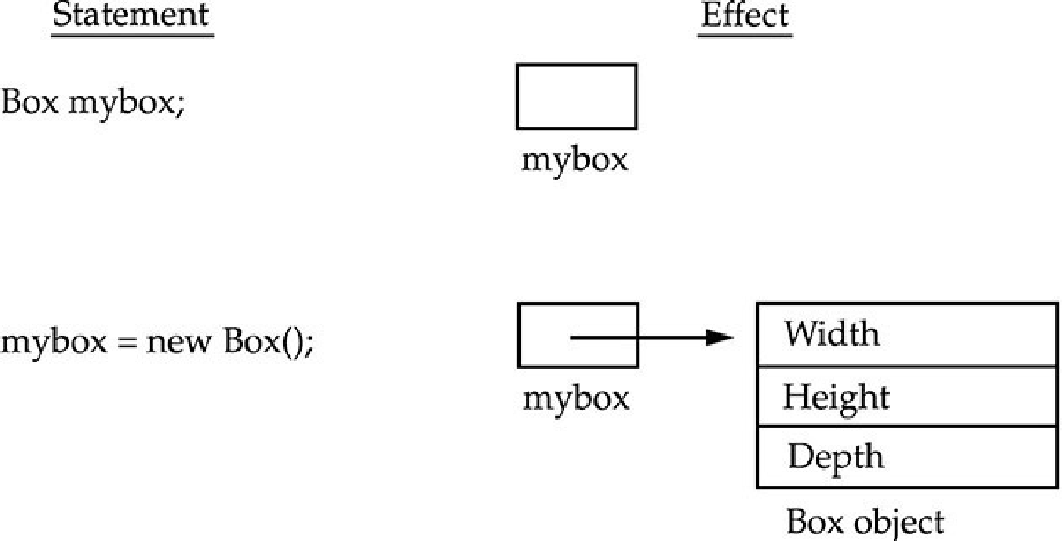
Contd…

Slide 7
Different ways to create objects
2) Java class.newInstance() method
Java class.newInstance() is the method of class class.
The class class belongs to java.lang package.
It creates a new instance of the class represented by this Class object.
It returns the newly created instance of the class.
Example

Slide 8
Different ways to create objects
3) Java newInstance() method of Constructor class
Java Constructor class also has a newInstance() method similar to newInstance() method of Class class.
newInstance() method belongs to
java.lang.reflect.Constructor class.
Both newInstance() method are known as reflective ways to create object.

Slide 9
Contd…
In fact the newInstance() method of Class class internally uses newInstance() method of Constructor class.
The method returns a new object created by calling the constructor.
The framework like Spring ,Struts and Hibernate internally uses this method for object creation.

Slide 10
Different ways to create objects
3) Java newInstance() method of Constructor class
The newInstance() method throws the following Exception:
IllegalAccessException: If the constructor is inaccessible.
IllegalArgumentException: If the actual and formal parameter differ in number.
InstantiationException: If the class constructor represents an abstract class.
InvocationTargetException: If the underlying constructor throws an exception.
ExceptionInInitializerError: If the initialization provoked by this method fails. Example

Slide 11
Different ways to create objects
4) Java Object.clone() method
Java clone() method creates a copy of an existing object.
It is defined in Object class. It returns clone of this instance.
The two most important point about clone() method is:
The Cloneable interface must be implemented while using clone() method. It is defined in java.lang package.
The clone() method must override with other classes.

Slide 12
Different ways to create objects
4) Java Object.clone() method
When we use clone() method in class, the class must call super.clone() to obtain the cloned object reference.
The method throws the CloneNotSupportedException if the Object class does not support the Cloneable interface.
Example

Slide 13
Different ways to create objects
5) Java Object Serialization and Deserialization
Whenever we serialize and then deserialize an object JVM creates a separate object for us
A class must implement Serializable interface which belongs to java.io package.
The Serializable interface does not have any method and field.
They add special behavior to the class.
JVM creates a separate space whenever we serialize and deserialize an object. It does not use any constructor to create an object.

Slide 14
Different ways to create objects
5) Java Object Serialization and Deserialization
The Serialization is a process of converting an object into a sequence of bytes.
The ObjectOutputStream class is used to serialize an object.
The writeObject() method of ObjectOutputStream class serialize an object and write the specified object to the ObjectOutputStram class.
The method accepts an object as a parameter.

Slide 15
Access Modifiers
Encapsulation links data with the code that manipulates it.
However, encapsulation provides another important attribute: access control.
Through encapsulation, we can control what parts of a program can access the members of a class.
By controlling access, we can prevent misuse.
Use of Access modifiers provides encapsulation.
These are keywords that specify the level of access, or protection, control the visibility of class members .

Slide 16
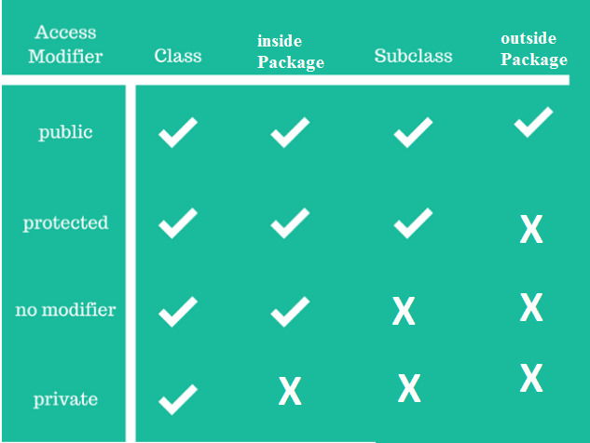
Access Modifiers
Public: Accessible from any other class
Private: Accessible only inside its own class
Protected: Accessible inside the same package and to the sub-classes in different packages.
Default: Accessible inside the same package. Members created without any access modifier will have this access.

Slide 17
Access Modifiers
Public:
When a member of a class is specified by public, then that member can be accessed by any other code.
The access level of a public modifier is everywhere.
It can be accessed from within the class, outside the class, within the package and outside the package.
main() has always been preceded by the public modifier.
It is called by code that is outside the program—that is, by the Java run-time system.

Slide 18
Access Modifiers
Private:
When the private modifier is applied to class members, they can only be accessed inside their current class.
Code inside subclasses cannot access the variable or method, nor can code from any external class.
Even if using the object , we cannot access a private members of a class .
Example

Slide 19
Accessing private Fields via Accessor Methods
Private:
Fields are often declared private to control the access to them from the outside world.
In some cases the fields are truly private, meaning they are only used internally in the class.
In other cases the fields can be accessed via accessor methods (e.g. getters and setters).
Example

